Slide 1
Python tutorial week 1: Anaconda + Jupyter Notebook
November 26, 2018

Slide 2
Tutorial structure
Week 1 (Feb. 28 2018)
Install Python via Anaconda
Jupyter Notebook introduction
git/github and conda environments
Week 2 (Mar. 7 2018)
Python basics
More on git/github

Slide 3
Today
• Download week 1 materials
• Download/install Python via Anaconda (or Miniconda)
• Python’s history
• Python’s structure
• IPython and Jupyter Notebook

Slide 4
Before we start… get this week’s material
Grab course materials from GitHub
Recommended: clone the repository using “git clone”
Open a terminal shell, cd into a directory where you’d like to keep contents from this tutorial, and enter the command below. The repository will be downloaded into the folder ESS-Python-Tutorial.
git clone https://github.com/bairdlangenbrunner/ESS-Python-Tutorial

Slide 5
Before we start… get this week’s material
Grab course materials from GitHub
If you don’t have git on your computer…
Download/unzip the contents the GitHub repository directly at:
https://github.com/bairdlangenbrunner/ESS-Python-Tutorial

Slide 6
Before we start… download Anaconda
If you’re working on a personal laptop:
Download Anaconda (recommended: Python 3.7)
https://www.anaconda.com/download/
There’s also a “lightweight” version called Miniconda, if your computer is very short on memory (or internet is slow):
https://conda.io/miniconda.html
If you already have it, run the Anaconda installer on your machine (following default install settings)

Slide 7
Before we start… download Anaconda
If you’re working on a remote machine (e.g., greenplanet), download it remotely on the machine:
1. ssh into the remote machine and cd into your home directory
2. wget the install file (Linux and Mac options below):
wget https://repo.anaconda.com/archive/Anaconda3-5.3.1-MacOSX-x86_64.sh
or
https://repo.anaconda.com/archive/Anaconda3-5.3.1-Linux-x86_64.sh
Run the sh file, go with the default settings:
bash Anaconda3-5.3.1-Linux-x86_64.sh

Slide 8
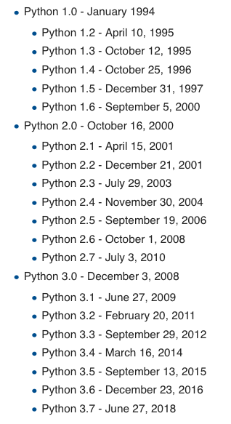
History of Python
Python 1
Python 2 – released 2000
Sunset date: was 2015, now 2020
Python 2.7 is considered “legacy”
Still used, though (e.g., UVCDAT)
print a
Python 3 – released 2008
Major overhaul to language
Most changes are behind the scenes
print(a)

Slide 9
History of Python
Official development happens via “Python Enhancement Proposals,” or PEPs
PEP 8: Style guide for Python code
https://www.python.org/dev/peps/pep-0008/
Stylized website version:
https://pep8.org/
High-level take-home points:
Indentation matters in Python (4 spaces preferred, not tabs)
Code should be 79 characters in width, then use continuation character: \
Use spaces for clarity (a = 5, not a=5).
But rules should be broken if it’s a matter of readability

Slide 10
Python structure (compared to MATLAB)
Numpy for MATLAB users (from python.org):
https://docs.scipy.org/doc/numpy-1.15.0/user/numpy-for-matlab-users.html
http://www.pyzo.org/python_vs_matlab.html

Slide 11
Python structure
Core Python (lightweight, fast)
Numerical/scientific capabilities are imported as modules
Most useful: Numpy, Scipy, Matplotlib
IDEs = integrated development environments (like the MATLAB GUI); PyCharm, Spyder, etc.
http://www.pyzo.org/python_vs_matlab.html

Slide 12
Anaconda and conda
Anaconda is a free Python distribution that comes with conda, a package manager
Lets you install packages and will check dependencies/versions, keeping [almost] everything up-to-date
Also allows for different environments, so you can have working, parallel builds of Python 2.7 and 3.7
Comes with a ton of libraries (Numpy, Scipy, Matplotlib, etc.) preinstalled, so most of the work is already done
• Worth reading: 30-minute “getting started with conda” tutorial at
https://conda.io/docs/user-guide/getting-started.html
• See also: conda_cheatsheet.pdf in the week1 directory

Slide 13
Anaconda and conda
You should now have Anaconda/Miniconda installed…
Check if it’s working by typing python in a terminal shell:
which python
…or type:
python
You can also use the Anaconda Navigator (likely needed for Windows)

Slide 14
Anaconda and conda
Something like this should be returned:
Python 3.7.0 (default, Jun 28 2018, 07:39:16)
[Clang 4.0.1 (tags/RELEASE_401/final)] :: Anaconda, Inc. on darwin
Type "help", "copyright", "credits" or "license" for more information.
>>> |
If this works, congrats—you have a working Anaconda installation. To exit:
>>> exit() [return/enter]

Slide 15
conda environments
base = default
* = active
baird$ conda env list
#conda environments:
#
base * /Users/baird/miniconda3
cdo_stable /Users/baird/miniconda3/envs/cdo_stable
ncl_stable /Users/baird/miniconda3/envs/ncl_stable
nco_stable /Users/baird/miniconda3/envs/nco_stable
pangeo /Users/baird/miniconda3/envs/pangeo
py27 /Users/baird/miniconda3/envs/py27

Slide 16
conda environments
to use another installed environment, type:
source activate nco_stable
baird$ conda env list
#conda environments:
#
base * /Users/baird/miniconda3
cdo_stable /Users/baird/miniconda3/envs/cdo_stable
ncl_stable /Users/baird/miniconda3/envs/ncl_stable
nco_stable /Users/baird/miniconda3/envs/nco_stable
pangeo /Users/baird/miniconda3/envs/pangeo
py27 /Users/baird/miniconda3/envs/py27

Slide 17
Anaconda and conda
To list all the Python libraries installed by the active Anaconda/Miniconda environment, type:
conda list

Slide 18
Anaconda and conda
NOTE: If you’re using Mac/Linux, Anaconda supercedes the default Python on your computer by adding a PATH to bash_profile/bashrc
If you want to revert to the default Python on your machine, comment (put a # in front of) the red line below in your bash_profile/bashrc file (Mac):
# added by Anaconda 5.3.0 installer
export PATH="/Users/${USER}/anaconda/bin:$PATH"

Slide 19
Starting python (all from command line)
python
ipython
• Use Jupyter Notebooks
jupyter notebook
jupyter lab
• Use an “IDE” (spyder, pycharm)
spyder
pycharm

Slide 20
IPython and Jupyter Notebook
IPython = Interactive Python
• Command line interface for interactive computing, useful for troubleshooting code
• Used to have a “notebook” option
• ipython at the command line
Jupyter Notebook
• What ipython notebook is now called
• Interactive computing docs (.ipynb files) run via web browser
• Can be used for other languages, not just Python…
• jupyter notebook at the command line

Slide 21
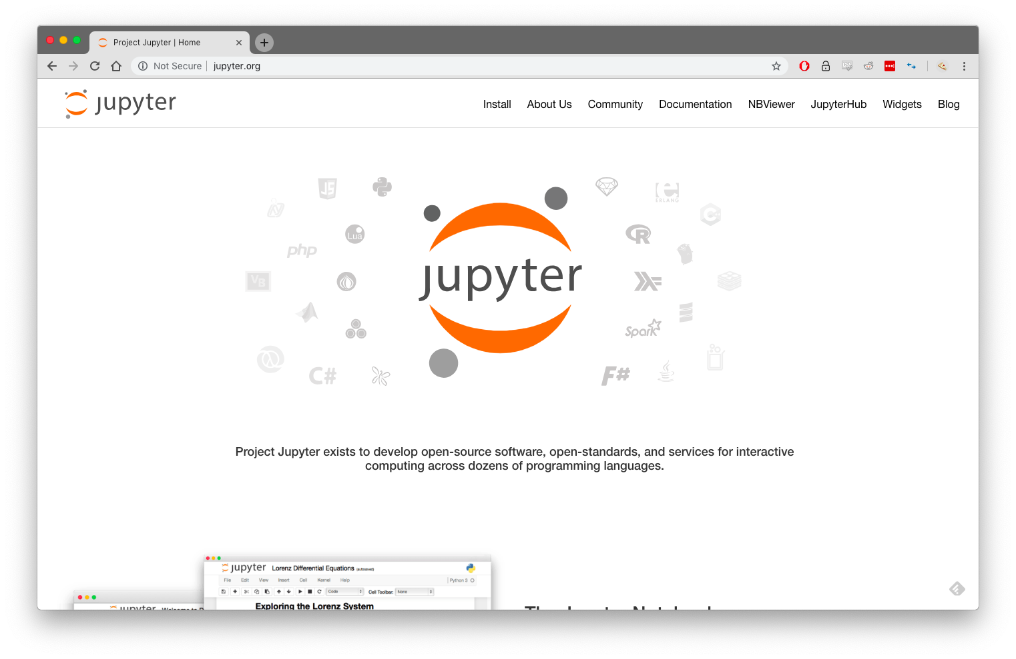
“Project Jupyter” – not just for Python (also R, Julia, etc.)

Slide 22
Jupyter Notebook
Open a terminal shell
Navigate to the folder for this week’s class materials (materials/week1), where week1_jupyter_intro.ipynb is located
Assuming Anaconda was successfully installed, open Jupyter Notebook by typing:
jupyter notebook

Slide 23
Unused slides

Slide 24
History of Python
Conceived by Guido van Rossum in the late 1980s
Dutch programmer who was bored during the 1989 Christmas holiday
Currently works at Dropbox (50% time on Python)
Wanted language that would “bridge the gap between C and the shell”
Name comes from Monty Python’s Flying Circus
Van Rossum is referred to as the BDFL: Benevolent Dictator for Life

Slide 25
History of Python
Official development happens via “Python Enhancement Proposals,” or PEPs
New features/implementations
Guidelines, info, and recommendations for Python community
Meta-PEPs on development at large
PEP 20: The “Zen of Python,” by Tim Peters
20 guiding design principles
Only 19 were written down…(?)
python
>>> import this

